Slide 1
ANN
Artificial Neural Network – PART 1
Pankaj

Slide 2
ANN – ARITIFICAL NEURAL NETWORK
What will we learn in this section :
The Neuron
The Activation Function
How do Neural Networks work ? (example)
How do Neural Networks learn ?
Gradient Descent
Stochastic Gradient Descent
Backpropagation
The way forward :

Slide 3
ANN – ARITIFICAL NEURAL NETWORK
What will we learn in this section :
The Neuron
The Activation Function
How do Neural Networks work ? (example)
How do Neural Networks learn ?
Gradient Descent
Stochastic Gradient Descent
Backpropagation
The way forward :

Slide 4
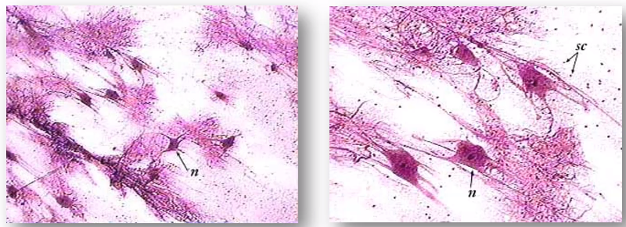
ANN – THE Neuron
Real Neuron in Human Body
Neuron

Slide 5
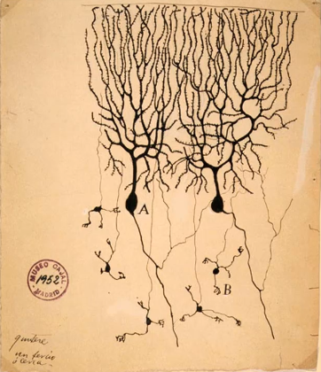
ANN – THE Neuron
This imange was created by Spanish neuroscientist Santiago Roman in 1899.
He dyed neuron in actual brain tissue
DL

Slide 6
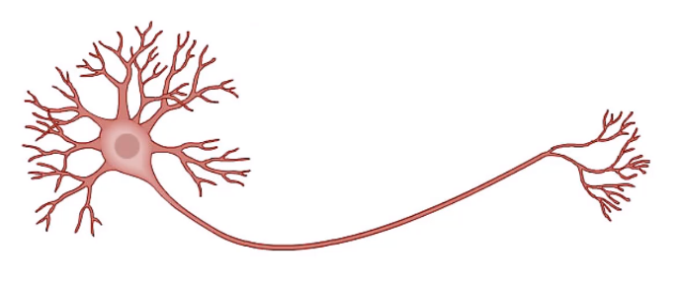
ANN – THE Neuron
This is the Actual Neuron

Slide 7
ANN – THE Neuron
Neuron
This is the Actual Neuron

Slide 8
ANN – THE Neuron
Dendrites
Neuron
This is the Actual Neuron

Slide 9
ANN – THE Neuron
Dendrites
Axon
Neuron
Neuron on its own in nothing, but think of single neuron as Ant. Together they are a force to reckon

Slide 10
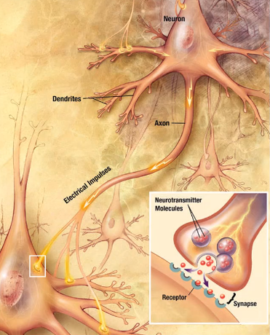
ANN – THE Neuron
How Neuron are connected.

Slide 11
ANN – THE Neuron
NEURON
This represent out Human Brain

Slide 12
ANN – THE Neuron
Input Signal 1
NEURON
Input Signal 2
Input Signal 3

Slide 13
ANN – THE Neuron
Input Signal 1
NEURON
Input Signal 2
Output Signal
Input Signal 3
DL

Slide 14
ANN – THE Neuron
X1
Input Value 1
NEURON
X2
Input Value 2
Output Signal
X3
Input Value 3
There are 5 senses from which Human Brain receives Signal, in ML/DL it is basically our Input Values

Slide 15
ANN – THE Neuron
X1
Input Value 1
NEURON
X2
y
Input Value 2
Output Signal
.
.
.
Xm
Input Value m
DL

Slide 16
ANN – THE Neuron
X1
Input Value 1
NEURON
X2
y
Input Value 2
Output Signal
.
.
.
Xm
Input Value m
Synapse
Signal is passed through Synapses

Slide 17
ANN – THE Neuron
X1
Input Value 1
Independent Variable
NEURON
X2
y
Input Value 2
Output Signal
Independent Variable
.
.
.
Independent Variable
Xm
Input Value m
DL

Slide 18
ANN – THE Neuron
X1
Input Value 1
Independent Variable
NEURON
X2
y
Input Value 2
Output Signal
Independent Variable
.
.
.
Independent Variable
Xm
Input Value m
Standardize
DL

Slide 19
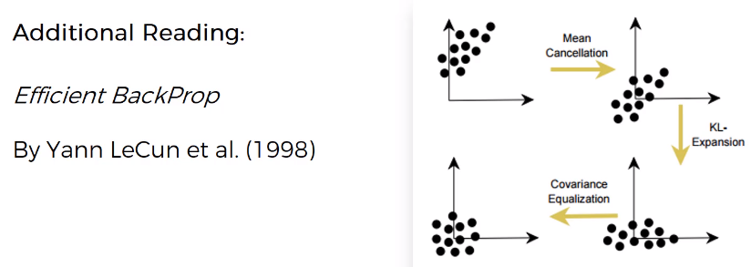
ANN – THE Neuron
Link : http://yann.lecun.com/exdb/publis/pdf/lecun-98b.pdf

Slide 20
ANN – THE Neuron
X1
Input Value 1
Independent Variable
NEURON
X2
y
Input Value 2
Output Value
Independent Variable
.
.
.
Independent Variable
Xm
Input Value m
DL

Slide 21
ANN – THE Neuron
X1
Input Value 1
Independent Variable
NEURON
X2
y
Input Value 2
Output Value
Independent Variable
.
.
.
Can be:
Continuous (price)
Independent Variable
Xm
Input Value m
DL

Slide 22
ANN – THE Neuron
X1
Input Value 1
Independent Variable
NEURON
X2
y
Input Value 2
Output Value
Independent Variable
.
.
.
Can be:
Continuous (price)
Binary (will exist yes/no)
Independent Variable
Xm
Input Value m
DL

Slide 23
ANN – THE Neuron
X1
Input Value 1
Independent Variable
NEURON
X2
y
Input Value 2
Output Value
Independent Variable
.
.
.
Can be:
Continuous (price)
Binary (will exist yes/no)
Categorical
Independent Variable
Xm
Input Value m
DL

Slide 24
ANN – THE Neuron
X1
Input Value 1
y
Independent Variable
Output Value
NEURON
X2
y
Input Value 2
Output Value
Independent Variable
.
.
.
y
Independent Variable
Output Value
Xm
Input Value m
DL

Slide 25
ANN – THE Neuron
X1
Input Value 1
Independent Variable
NEURON
X2
y
Input Value 2
Output Value
Independent Variable
.
.
.
Independent Variable
Xm
Input Value m

Slide 26
ANN – THE Neuron
X1
Input Value 1
Independent Variable
NEURON
X2
y
Input Value 2
Output Value
Independent Variable
.
.
.
Independent Variable
Xm
Input Value m

Slide 27
ANN – THE Neuron
X1
Input Value 1
Independent Variable
W1
NEURON
X2
W2
y
Input Value 2
Output Value
Independent Variable
.
.
.
Independent Variable
Wm
Xm
Input Value m
Sometime signal received to brain is weak or strong, Similarly we have weight which decides how the value is based to Hidden Layer

Slide 28
ANN – THE Neuron
X1
Input Value 1
Independent Variable
W1
?
X2
W2
y
Input Value 2
Output Value
Independent Variable
.
.
.
Independent Variable
Wm
Xm
Input Value m

Slide 29
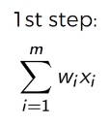
ANN – THE Neuron
X1
Input Value 1
Independent Variable
W1
X2
W2
y
Input Value 2
Output Value
Independent Variable
.
.
.
Independent Variable
Wm
Xm
Input Value m
First Step – To add all the weight to the Independent Variable we have received.

Slide 30
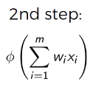
ANN – THE Neuron
X1
Input Value 1
Independent Variable
W1
X2
W2
y
Input Value 2
Output Value
Independent Variable
.
.
.
Independent Variable
Wm
Xm
Input Value m
Second Step – It is Activation Function

Slide 31
ANN – THE Neuron
X1
Input Value 1
Independent Variable
W1
X2
W2
y
Input Value 2
3 Step
Output Value
Independent Variable
.
.
.
Independent Variable
Wm
Xm
Input Value m
3rd Step – Information getting passed

Slide 32
ANN – ARITIFICAL NEURAL NETWORK
What will we learn in this section :
The Neuron
The Activation Function
How do Neural Networks work ? (example)
How do Neural Networks learn ?
Gradient Descent
Stochastic Gradient Descent
Backpropagation
The way forward :

Slide 33
ANN – THE Activation Function
X1
Input Value 1
W1
X2
W2
y
Input Value 2
3 Step
Output Value
.
.
.
Wm
Xm
Input Value m
Single Neuron Structure

Slide 34
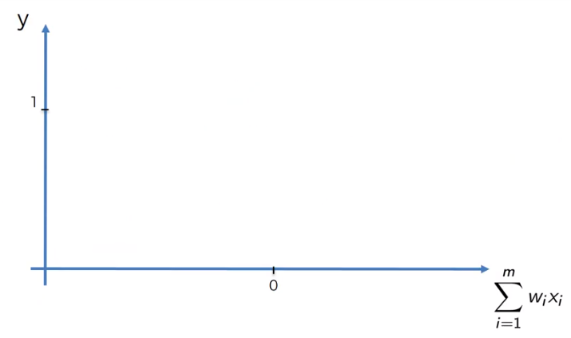
ANN – THE Activation Function
4 Main Activation Function which are generally used.

Slide 35

ANN – THE Activation Function
1. Threshold Function

Slide 36
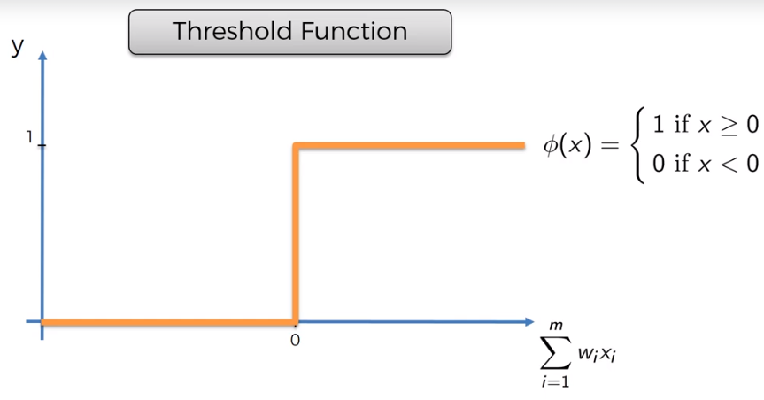
ANN – THE Activation Function
1. Threshold Function

Slide 37
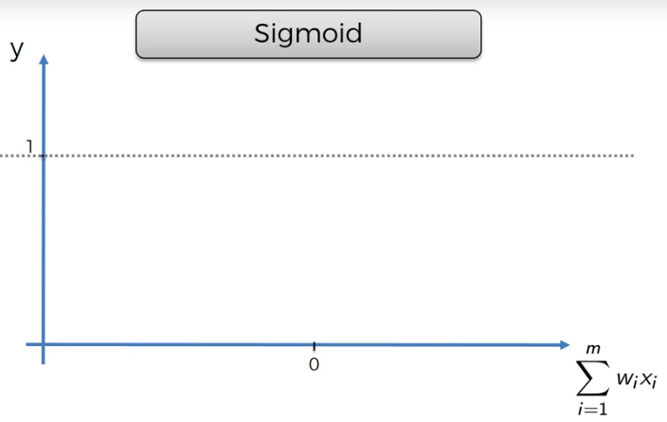
ANN – THE Activation Function
2. Sigmoid Function

Slide 38
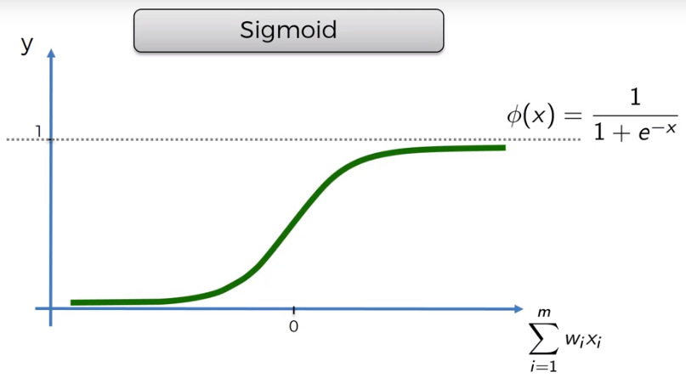
ANN – THE Activation Function
2. Sigmoid Function

Slide 39
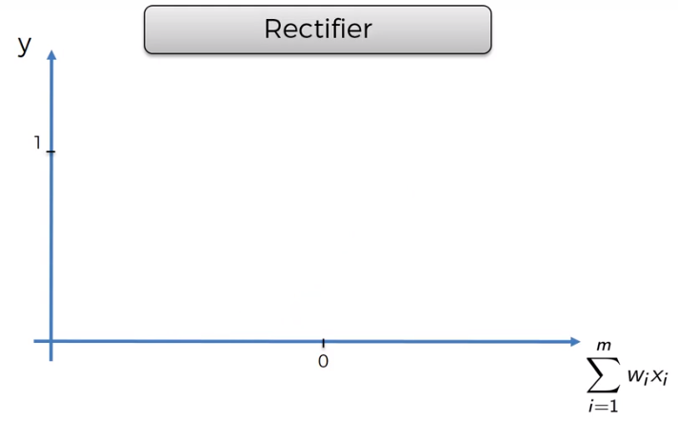
ANN – THE Activation Function
3. Rectifier Function

Slide 40
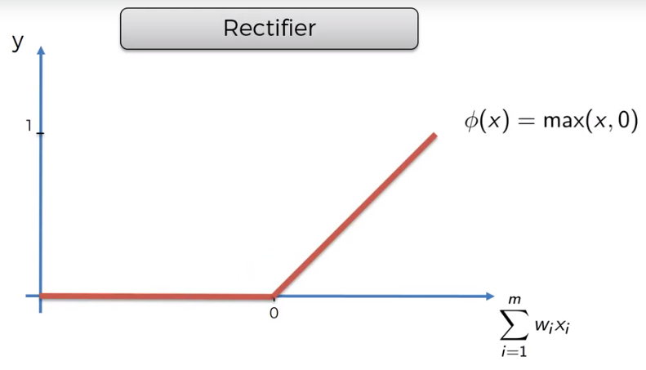
ANN – THE Activation Function
3. Rectifier Function – This is one of the most popular function for ANN.

Slide 41
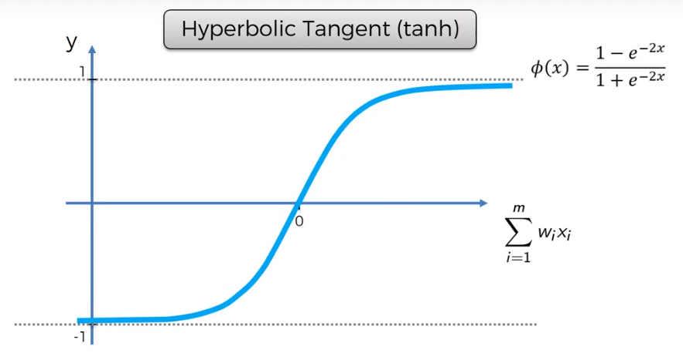
ANN – THE Activation Function
4. Hyperbolic Tangent Function (tanh)

Slide 42
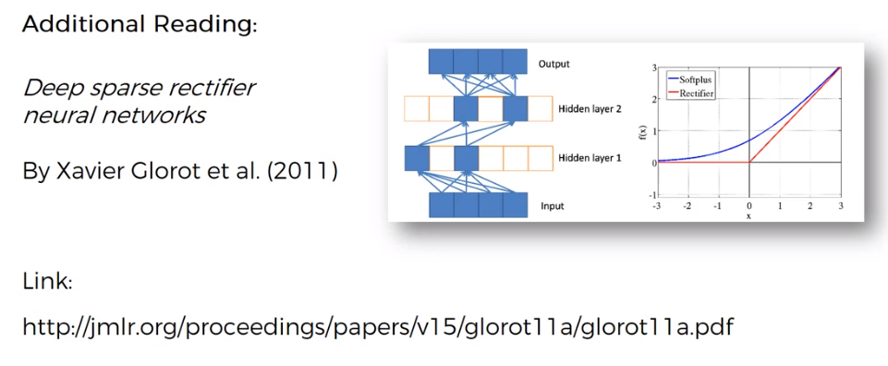
ANN – THE Activation Function
Link: http://jmlr.org/proceedings/papers/v15/glorot11a/glorot11a.pdf

Slide 43
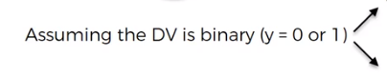
ANN – THE Activation Function
X1
Input Value 1
W1
X2
W2
y
Input Value 2
3 Step
Output Value
.
.
.
Wm
Xm
Input Value m
Lets Test our Knowledge ? What Activation will be apply in this case

Slide 44
ANN – THE Activation Function
X1
Input Value 1
W1
X2
W2
y
Input Value 2
3 Step
Output Value
.
.
.
Wm
Xm
Input Value m
Answer is 2

Slide 45
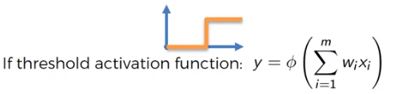
ANN – THE Activation Function
X1
Input Value 1
W1
X2
W2
y
Input Value 2
3 Step
Output Value
.
.
.
Wm
Xm
Input Value m
First is threshold Activation Function since, it has only 2 output.

Slide 46
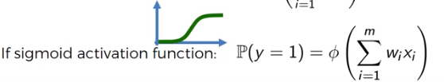
ANN – THE Activation Function
X1
Input Value 1
W1
X2
W2
y
Input Value 2
3 Step
Output Value
.
.
.
Wm
Xm
Input Value m
Second is Sigmoid Function

Slide 47
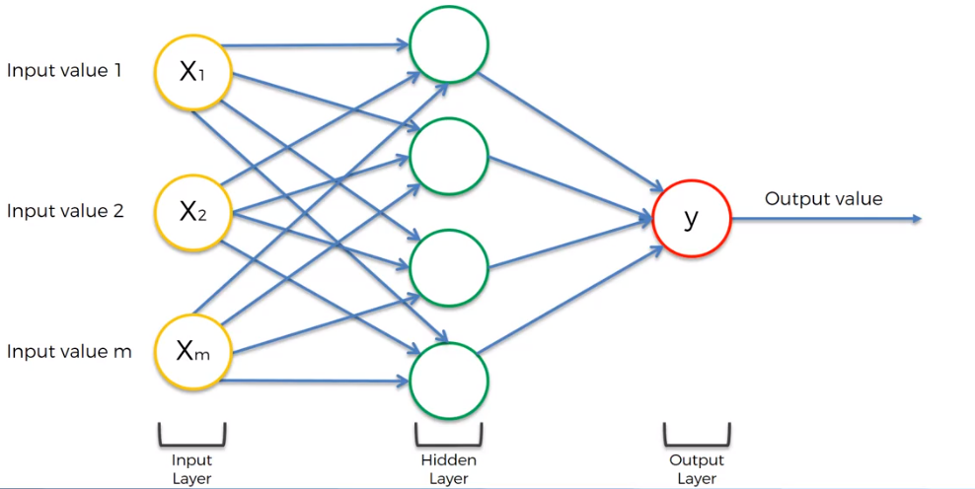
ANN – THE Activation Function
Let’s understand the flow

Slide 48
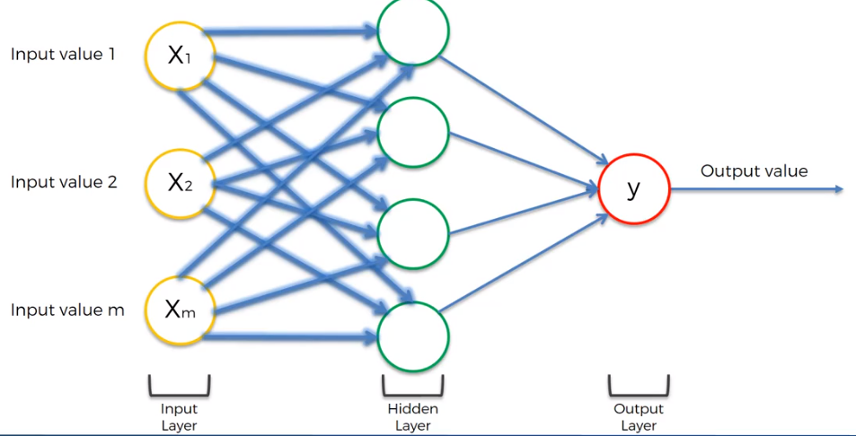
ANN – THE Activation Function
Initially the weight is applied on the Input value and pass to the Neurons

Slide 49
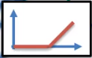
ANN – THE Activation Function
Activation Function is applied at the Hidden Layer

Slide 50
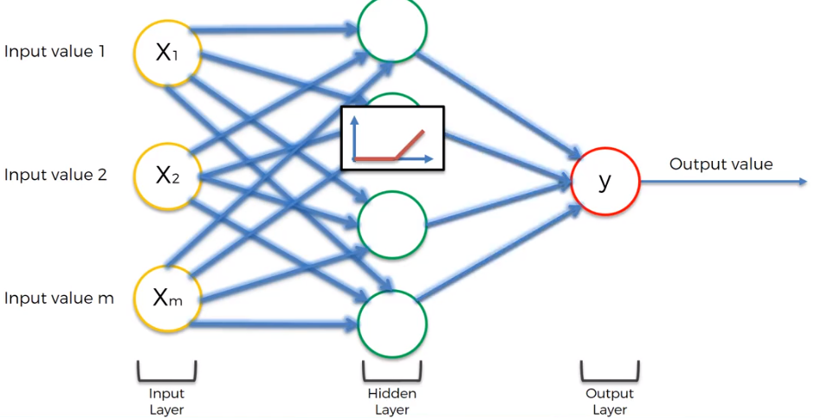
ANN – THE Activation Function
Then the result is passed to Output Layer

Slide 51
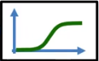
ANN – THE Activation Function
The Second Activation is applied at Output Layer to provide the desired result.

Slide 52
ANN – ARITIFICAL NEURAL NETWORK
What will we learn in this section :
The Neuron
The Activation Function
How do Neural Networks work ?
How do Neural Networks learn ?
Gradient Descent
Stochastic Gradient Descent
Backpropagation
DL

Slide 53

ANN – How do Neural Network WORKS ?
We will look at an example of Property Valuation

Slide 54
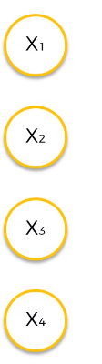
ANN – How do Neural Network WORKS ?
DL

Slide 55
ANN – How do Neural Network WORKS ?
DL

Slide 56
ANN – How do Neural Network WORKS ?
Input Layer
DL

Slide 57
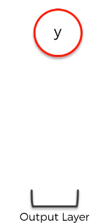
ANN – How do Neural Network WORKS ?
Input Layer
DL

Slide 58
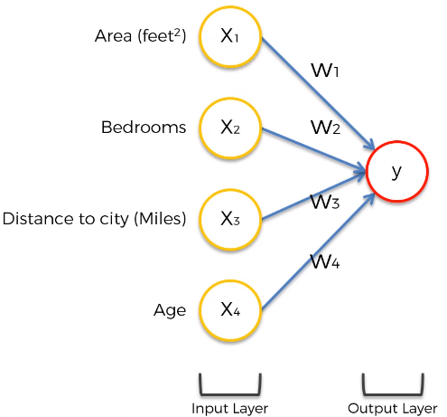
ANN – How do Neural Network WORKS ?
DL

Slide 59
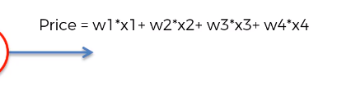
ANN – How do Neural Network WORKS ?
This is generic way we can make prediction

Slide 60
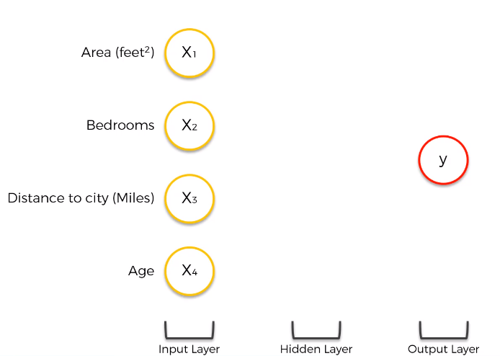
ANN – How do Neural Network WORKS ?
But, In Neural Network, we have power of Hidden Layer.

Slide 61
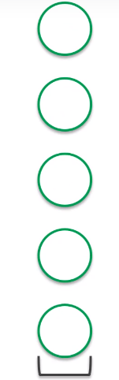
ANN – How do Neural Network WORKS ?
We are going to understand, how Neural Network work? …..

Slide 62
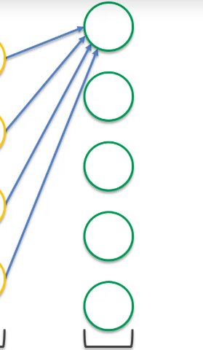
ANN – How do Neural Network WORKS ?
We are going to understand, how Neural Network work? …..

Slide 63
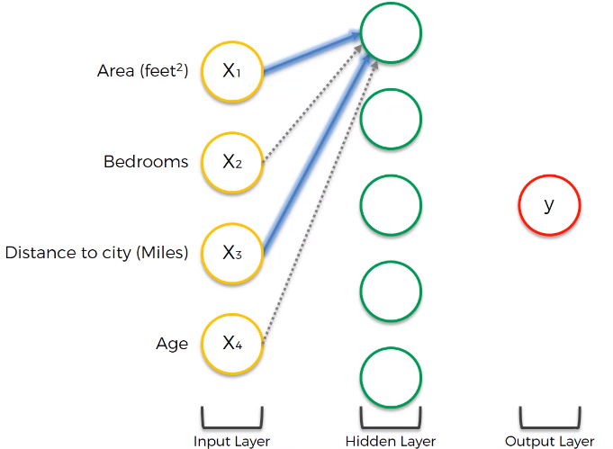
ANN – How do Neural Network WORKS ?
Each Synapses has weight, non-highlighted has zero weight.

Slide 64
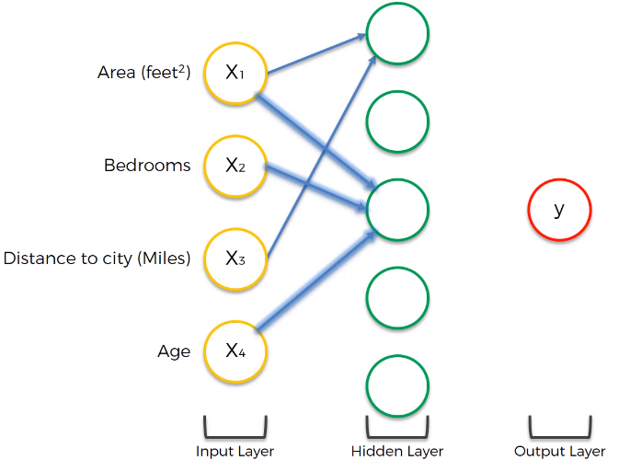
ANN – How do Neural Network WORKS ?
DL

Slide 65
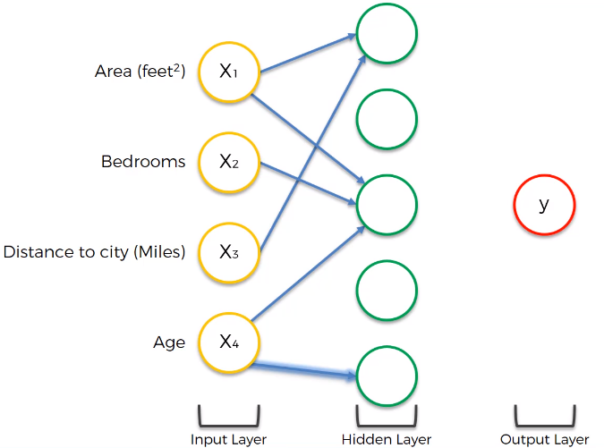
ANN – How do Neural Network WORKS ?
DL

Slide 66
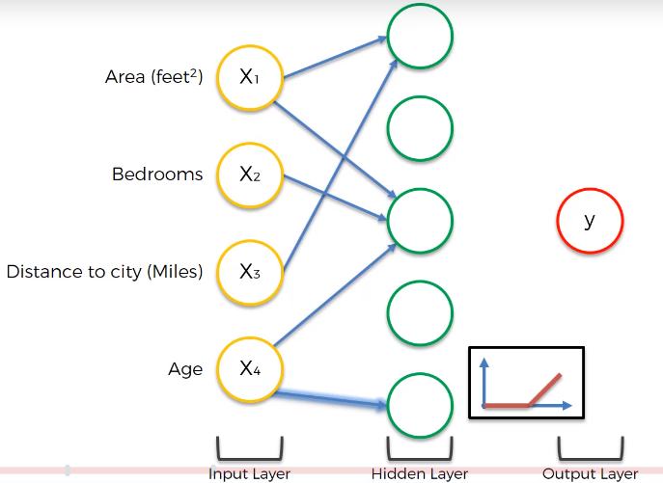
ANN – How do Neural Network WORKS ?
DL

Slide 67
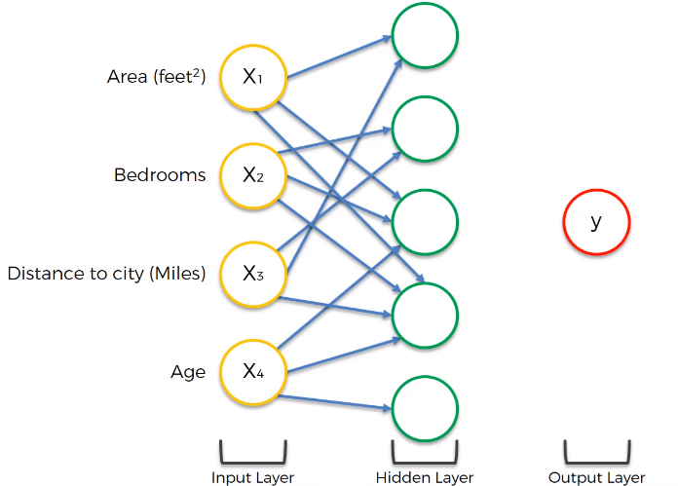
ANN – How do Neural Network WORKS ?
DL

Slide 68
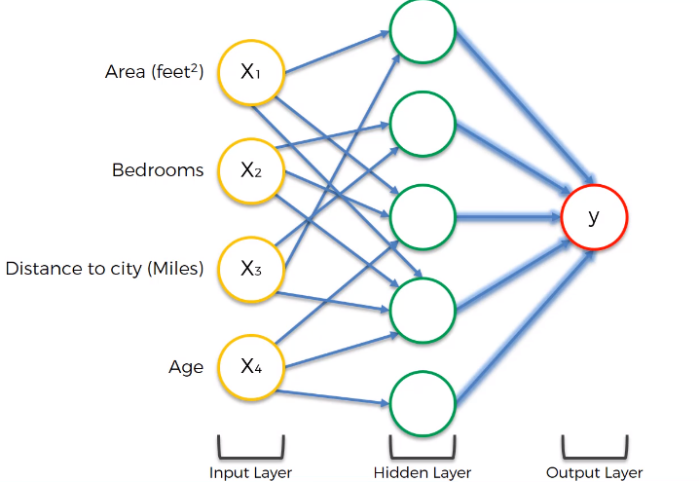
ANN – How do Neural Network WORKS ?
DL

Slide 69
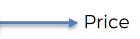
ANN – How do Neural Network WORKS ?
DL

